Slide 1
A
Presentation on
SMART HEALTH MONITORING SYSTEM
5G IOT Builder OSDA FITT IITD
Presented By:
Tejaswini Pradhan

Slide 2
Contents: 1. Abstract 2. Introduction: Basic Idea 3. Block Diagram 4. Components Used 5. Working 6. Application 7. Result/Output 8. Conclusion 9. Prospects 10. References 11. Conclusion

Slide 3
Abstract
The propose of IoT-based advanced personal health monitoring and medicine box system to enhance biomedical applications. The system integrates IoT with healthcare to monitor patient health and manage medicine intake. It comprises a wristband, data recorder, and medicine box, using noninvasive methods to gather health data. This data is stored in the cloud and shared with linked contacts and doctors via an Android app. The medicine box tracks consumption and features an emergency button to alert contacts.
By improving health monitoring and record-keeping, the system aims to maintain population wellness effectively.
Profits are up, and losses are down! We are very proud of the progress our team has made. Today we’ll review our wins and losses from last year and give you an overview of what you can expect for next year.

Slide 4
Introduction: Basic Idea
Health monitoring system offers many benefits to people’s lives, especially for those who have chronic diseases and need daily observation. This health monitoring system will improve quality of life.
Information technology (IT) and wireless communication system has the potential to improve the safety, quality, and efficiency of health care.
With this improvement in technology, doctors and patients can easily access and use health information as needed.
Profits are up, and losses are down! We are very proud of the progress our team has made. Today we’ll review our wins and losses from last year and give you an overview of what you can expect for next year.

Slide 5
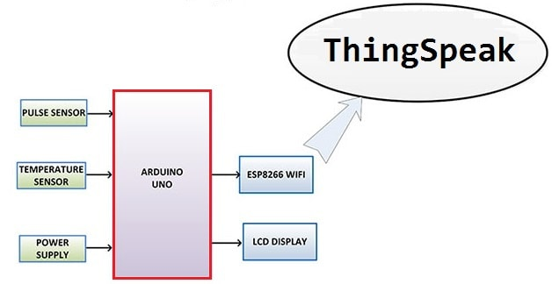
Block Diagram

Slide 6
Component used
Sl.no component name:
1. Arduino Nano Board(1)
ESP8266-01 Wi-Fi Module(1)
16x2 LCD Display(1)
Pulse Sensor(1)
LM35 Temperature Sensor(1)
2K Resistor(1)
1K Resistor(1)
LED 5mm Any Color
Connecting Wires(10-20)
Breadboard

Slide 7
Working:
Arduino processes the data to calculate BPM and body temperature.
LCD displays the values, giving real-time feedback to the user.
ESP8266 sends the data to a remote server for further analysis or monitoring.
Sensors collect health data (heart rate and temperature).
The LED blinks to provide feedback for heartbeats or system activity.

Slide 8
Application:
In a few cases patients need to be observed quite frequently after they are discharged from the hospital.
For check-up they might need to come to the Doctor every weekend in that case A smart Wearable device can save time and cost by providing the doctor an Interface to go through the real-time and weekly report
All the patient’s Health logs can be stored in the cloud, which can be used by Doctors for better analysis of patient Health
In emergency cases it can also trigger SMS notification to the family members so that they can take him/her to Hospital

Slide 9
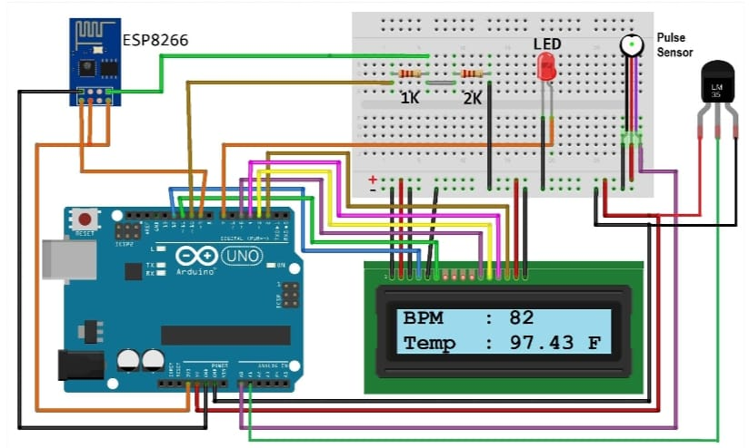
Result/Output
Profits are up, and losses are down! We are very proud of the progress our team has made. Today we’ll review our wins and losses from last year and give you an overview of what you can expect for next year.

Slide 10
Conclusion
In the Health Sector Wearable devices will play a very important role in connecting Patients & Doctors
It will help in Tracking the health of patients in Real time
Various security issues need to be addressed like transmission of secured data.
Better Health Analytics based on current & future data
Profits are up, and losses are down! We are very proud of the progress our team has made. Today we’ll review our wins and losses from last year and give you an overview of what you can expect for next year.

Slide 11
Prospects
Wearable devices will dominate in the future.
More powerful and compact devices will be available with the advancement in Technological infrastructure.
Mobile Sync will make it easier to track by family members.
With advancement in Artificial intelligence, better prediction & Analysis will help to take preventive measures.
Profits are up, and losses are down! We are very proud of the progress our team has made. Today we’ll review our wins and losses from last year and give you an overview of what you can expect for next year.

Slide 12
https://www.hackster.io/rajeshjiet/iot-based-health-monitoring-system-arduino-project-69056f( IoT Based Patient Health Monitoring System using ESP8266 & Arduino) https://www.ijert.org/research/an-iot-based-health-monitoring-system-using-arduino-uno-IJERTV10IS030268.pdf(Arduino collects real-time health data )
References

Slide 13
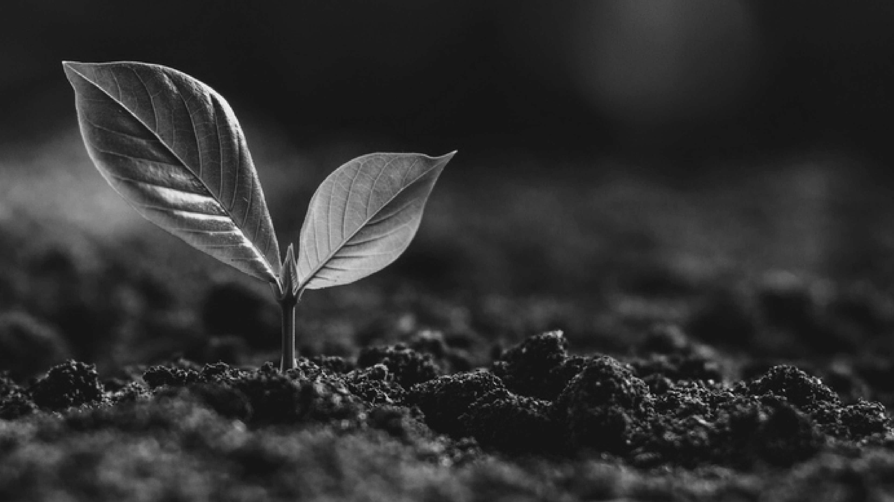
Any Query

Slide 14
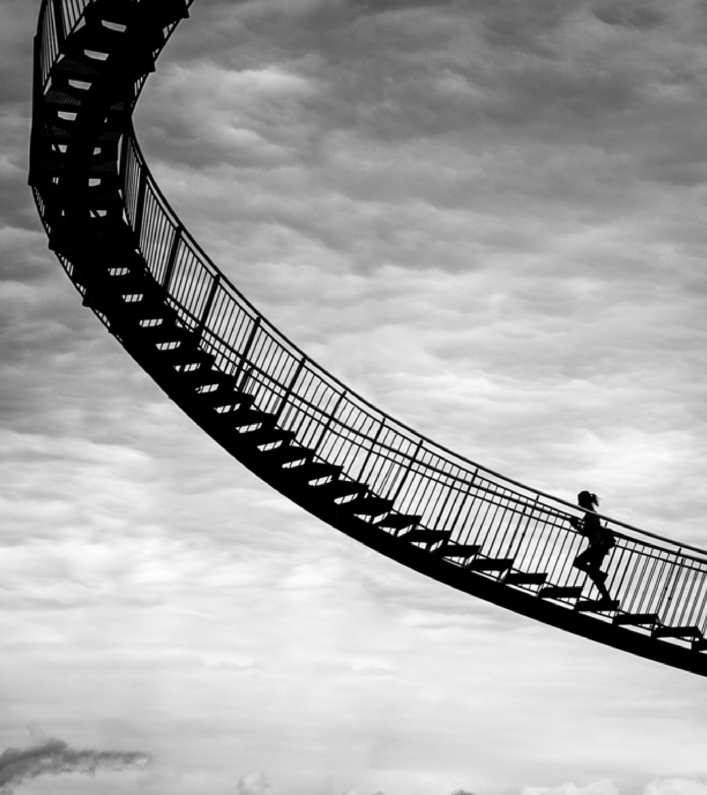
Thank you
Evaluated By: Dr. v. Venkantramanan
Prof., OSDA FITT IITD
Group No: 4
Tejaswini Pradhan

